Slide 1
Chapter 11: File System Implementation

Slide 2
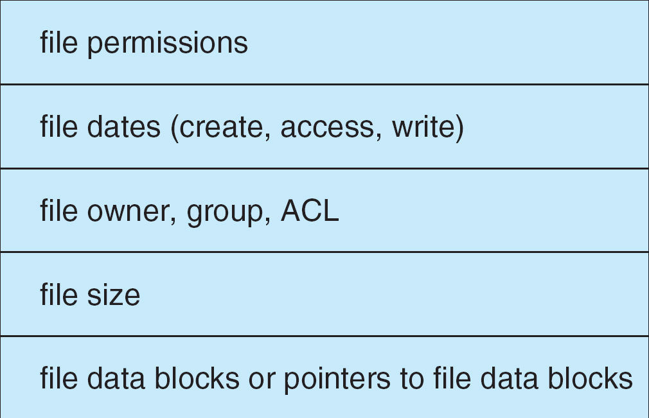

A Typical File Control Block
File control block (FCB) – storage structure consisting of information about a file

Slide 3
Allocation Methods
An allocation method refers to how disk blocks are allocated for files
  Contiguous allocation
  Linked allocation
  Indexed allocation

Slide 4
Contiguous Allocation
Each file occupies a set of contiguous blocks on the disk
Simple – only starting location (block #) and length (number of blocks) are required
Wasteful of space (external fragmentation).
Files cannot grow

Slide 5

Contiguous Allocation of Disk Space

Slide 6
Linked Allocation
Each file is a linked list of disk blocks: blocks may be scattered anywhere on the disk
Simple – need only starting address and ending address
Free-space management system – no waste of space
No random access
No external fragmentation

Slide 7

Linked Allocation

Slide 8

Indexed Allocation Method
Brings all pointers together into the index block.
Dynamic access without external fragmentation, but have overhead of index block

Slide 9

Combined Scheme: UNIX

Slide 10
Free-Space Management
To keep track of free disk space, maintain a free-space list
To create a file, we search the free-space list for the required
amount of space and allocate that space to the new file. This space
is then removed from the free-space list.
When a file is deleted, its disk space is added to the free-space list.
Bit vector /Bit map (n blocks)
0
1
2
n-1
…
0 ⇒ block[i] free
1 ⇒ block[i] occupied
bit[i] =

E.g: 001111001111111000001100000001111

Slide 11

Free-Space Management (Cont.)
Linked list (free list)
  Cannot get contiguous space easily
  No waste of space
Grouping:
  Store the addresses of n free blocks in the first free block
  The first n-1 of these blocks are actually free
  The last block contains the addresses of another n free locks
  ……
Counting
  List the start disk address and a count of contiguous free blocks

Slide 12
End of Chapter 11

